Slide 1

MODULE 3: PROGRAMMING FOR BIOLOGICAL DATA
Visualization & Reporting
ggtree and R Markdown
Instructor: Dr. Haogao Gu | Date: February 11, 2026

Slide 2

Welcome to the Final Session! 🎉
What You've Accomplished
•
Sessions 1-4: R Fundamentals (Data structures, dplyr)
•
Sessions 5-8: Statistics & Quality Control (t-tests, ANOVA, QC charts)
•
Sessions 9-11: Bioinformatics (Sequences, MSA, Trees)
Today's Goal
Learn to visualize complex data professionally and generate reproducible reports.

Slide 3








Learning Objectives
ggtree
Metadata
Export
R Markdown
Create publication-quality tree figures.
Annotate trees with clinical data (colors, labels).
Save figures as high-resolution PNG/PDF.
Understand reproducible reporting concepts.

Slide 4

Part 1: Advanced Visualization with ggtree
Turning Data into Insight

Slide 5
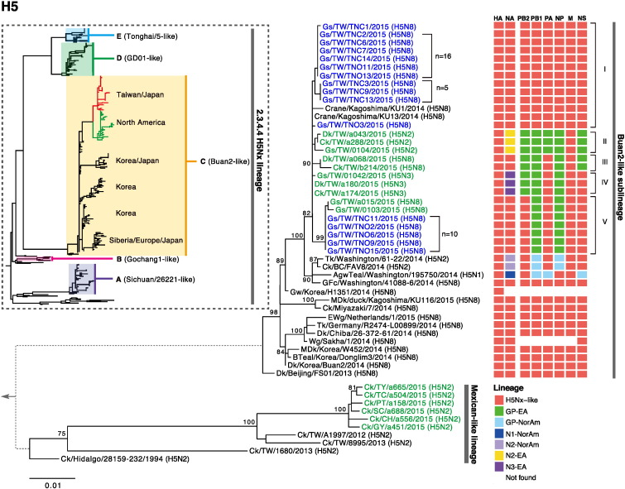

What is ggtree?
A Bioconductor package extending ggplot2 for phylogenetic trees.
•
Beautiful, publication-ready aesthetics.
•
Follows standard "Grammar of Graphics".
•
Easy layer addition (+ geom_...).
•
Flexible layouts (rectangular, circular, fan).

Slide 6
ggtree vs. Base R (ape)
Feature | ape plot() | ggtree
Appearance | Basic, functional | Polished, customizable
Customization | Limited parameters | Unlimited layers
Metadata | Manual mapping | Built-in support (%<+%)
Learning Curve | Low | Medium (ggplot style)

Slide 7
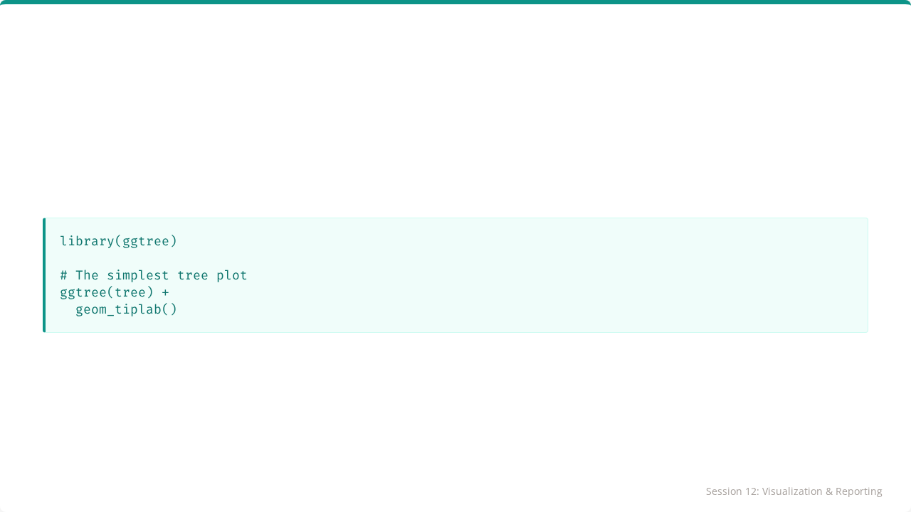
Basic ggtree Syntax
Just like ggplot(), we initialize the object and add geometric layers.

Slide 8
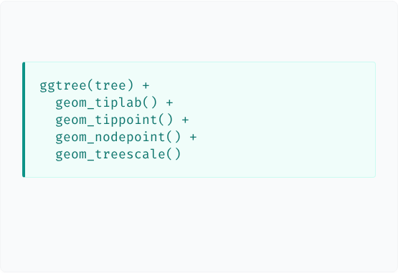

Adding Layers
Code
Explanation
•
geom_tiplab(): Adds text labels to tips.
•
geom_tippoint(): Adds dots to tips.
•
geom_nodepoint(): Adds dots to internal nodes.
•
geom_treescale(): Adds a distance scale bar.

Slide 9
Tree Layouts
# Rectangular (Standard) ggtree(tree, layout = "rectangular") # Circular (Compact for large trees) ggtree(tree, layout = "circular") # Fan (Spreads out tips) ggtree(tree, layout = "fan")

Slide 10
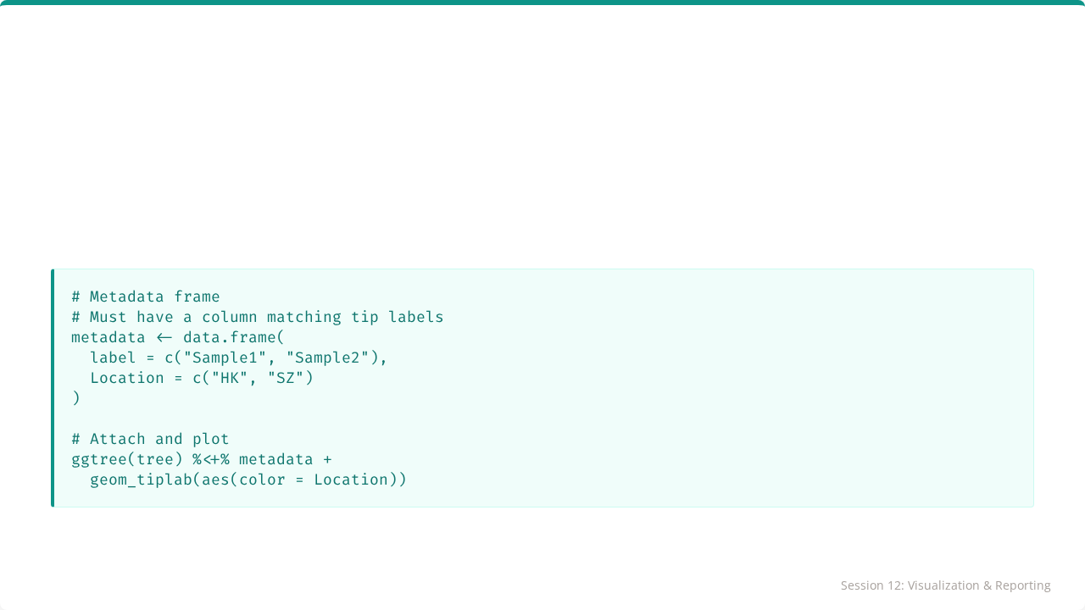
Attaching Metadata
The %<+% operator allows linking a data frame to the tree.

Slide 11
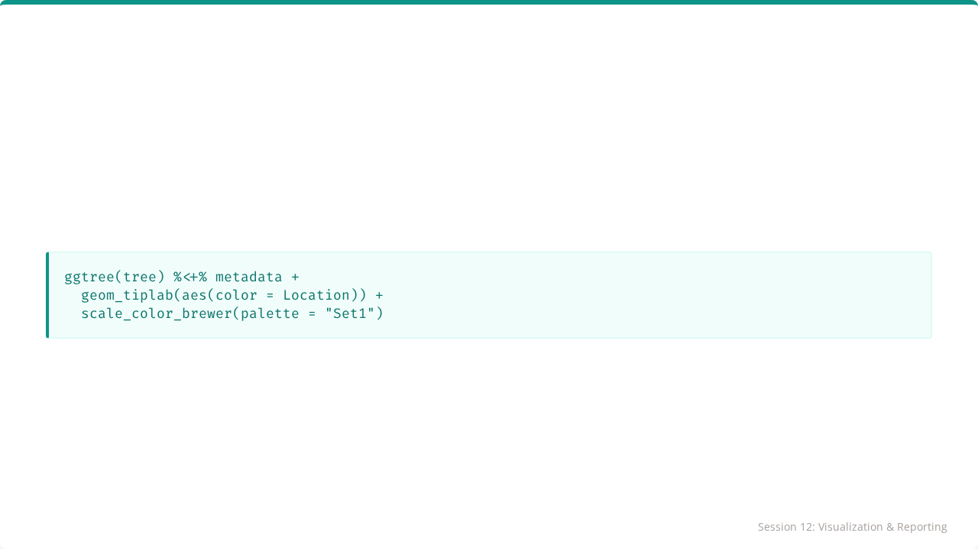
Coloring by Metadata
Any ggplot2 color scale works here!

Slide 12
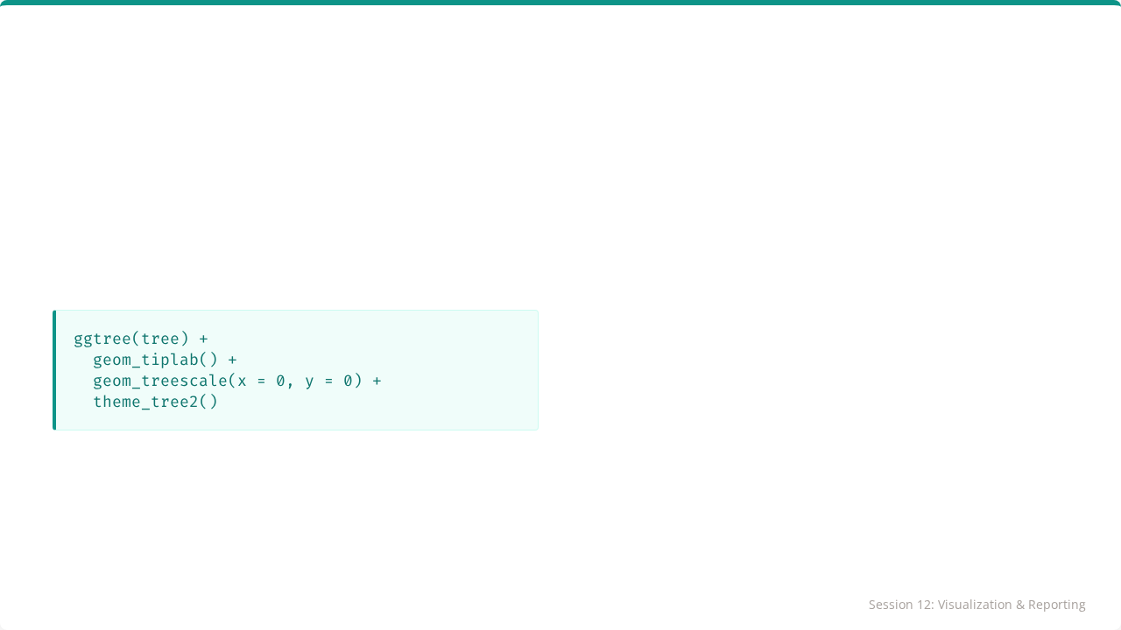
Adding a Scale Bar
geom_treescale(): Adds a floating scale bar.
theme_tree2(): Adds an X-axis with distance values.

Slide 13
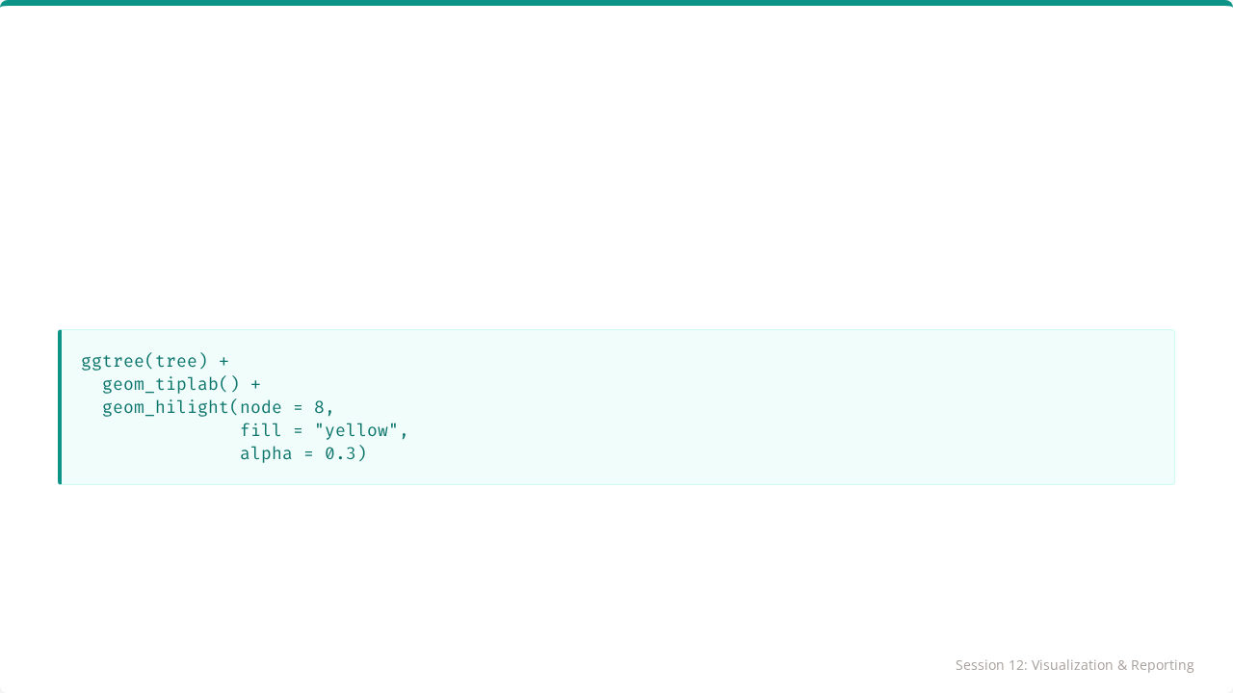
Highlighting Clades
Emphasize specific clusters (e.g., an outbreak group).
Requires knowing the internal node ID.

Slide 14
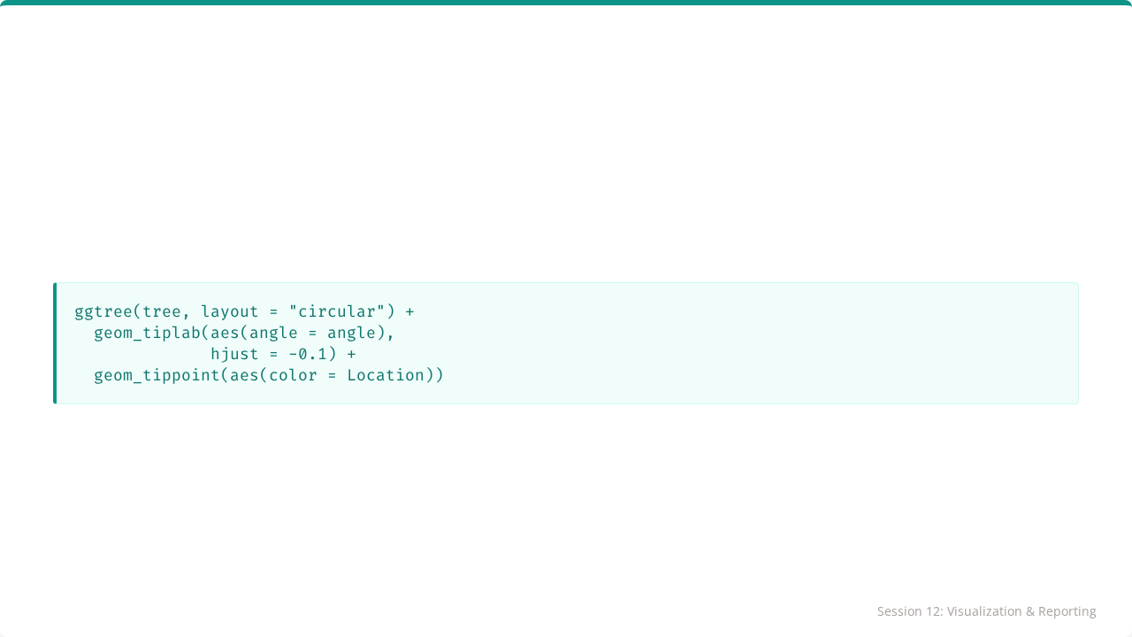
Circular Trees
Great for visualizing trees with many tips (50+).

Slide 15
Saving with ggsave()
# Assign plot to variable p <- ggtree(tree) + geom_tiplab() # Save as PNG (Raster) ggsave("tree.png", p, width = 8, height = 6) # Save as PDF (Vector) ggsave("tree.pdf", p, width = 8, height = 6)

Slide 16
Publication Tips
Use theme_tree2() for clear axes.
Set appropriate dimensions to avoid text overlap.
Use dpi = 300 for print quality.
Choose colorblind-friendly palettes.
Add clear legends.

Slide 17

Part 2: Local R Development
Moving Beyond the Cloud

Slide 18


Beyond Google Colab
Colab Limitations
Local Development
•
Disconnects after ~12 hours.
•
Persistent files.
•
Files lost when runtime recycles.
•
Full power of your machine.
•
Limited computing power.
•
Secure data storage.
•
Standard in professional settings.

Slide 19




The RStudio IDE
The standard professional interface for R.
1
2
3
4
Source
Console
Environment
Files/Plots
Write scripts here.
Run code immediately.
See your data.
Manage outputs.

Slide 20
The "R Project" (.Rproj)
The Solution
The Problem
R Projects set the working directory to the project folder automatically.
setwd("C:/Users/Haogao/Downloads/...")
This code breaks on anyone else's computer.
Portable: Send the folder to anyone, it just works!

Slide 21
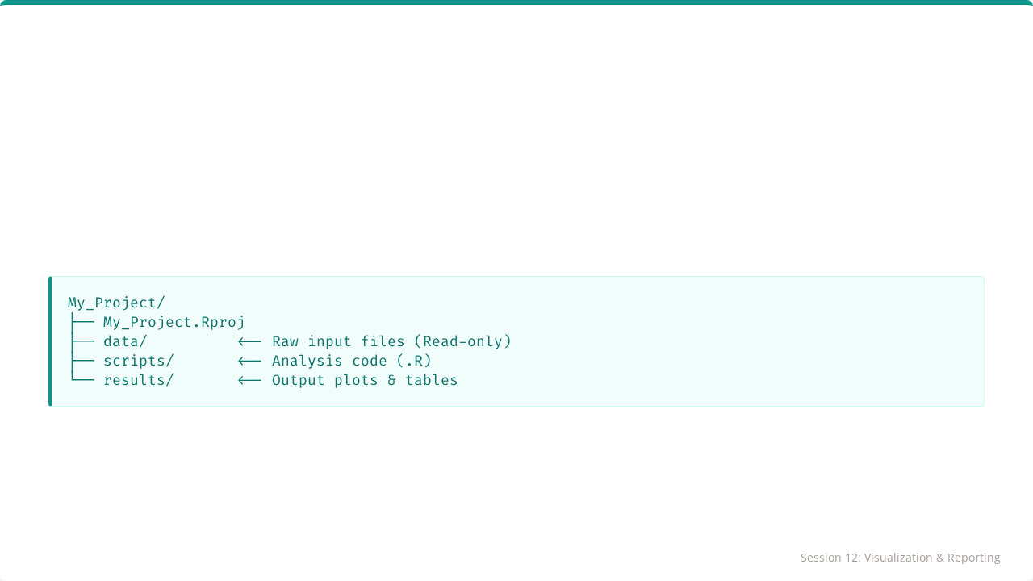
Standard Directory Structure
Organize your work like a pro:
Golden Rule: Keep inputs separate from outputs.

Slide 22
Scripts (.R) vs Notebooks (.ipynb)
Feature | Notebooks | Scripts
Use Case | Exploration, Teaching | Pipelines, Automation
Output | Inline HTML/PDF | Saved Files (PNG/CSV)
Execution | Cell by Cell | source("analysis.R")
Version Control | Difficult (JSON) | Easy (Plain Text)

Slide 23
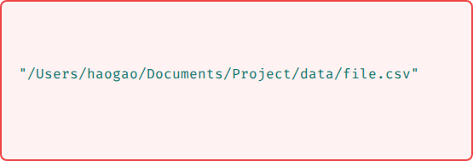
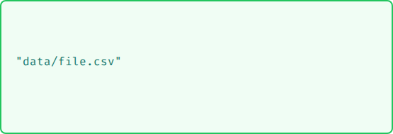
Managing File Paths
Absolute (BAD)
Relative (GOOD)
Only works on one computer.
Works anywhere inside the project folder.

Slide 24
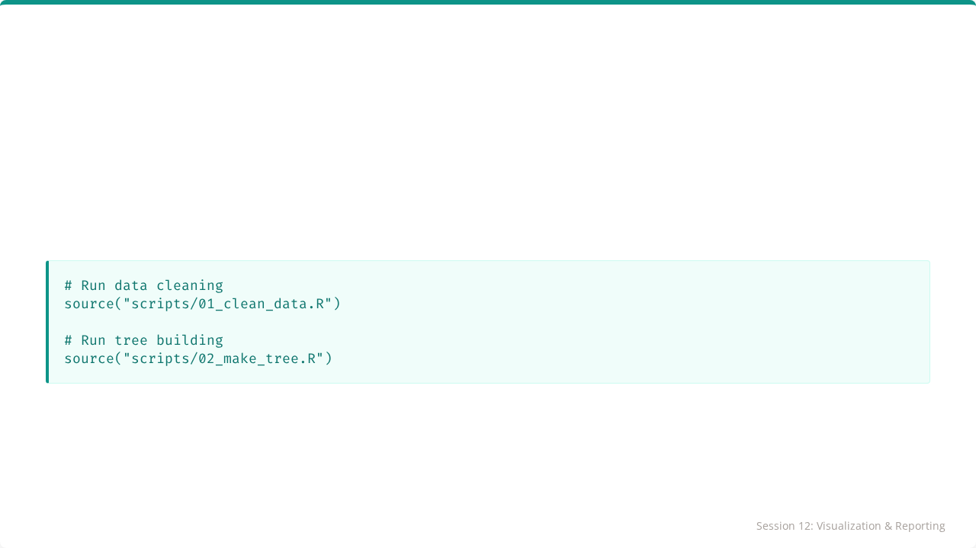
Running Scripts
You can automate an entire analysis with one command:
This ensures reproducibility from start to finish.

Slide 25
Installing Packages Locally
In Colab: You install every time.
Locally:
1.
Run install.packages("ggtree") ONCE.
2.
Use library(ggtree) in your scripts.
Libraries stay installed on your hard drive.

Slide 26
Key Takeaways
•
ggtree provides advanced visualization power.
•
RStudio + R Projects is the professional standard environment.
•
Relative Paths ensure portability.
•
Scripts (.R) enable reproducible automation.

Slide 27

🎓 Course Complete!
From Variables to Visualizations.
You are now R-Ready for Biological Data.

Slide 28

Tutorial 12
Setting Up Your Pipeline
Open your R environment

Slide 29
Tutorial 12: Setting Up Your Pipeline
Automating Analysis with Scripts

Slide 30
Your Scenario
The Task
You have finished an analysis in a notebook. Now, formalize it into a Reproducible Pipeline.
Steps:
1.
Set up directories.
2.
Create dummy data.
3.
Write an R script.
4.
Execute the pipeline.

Slide 31
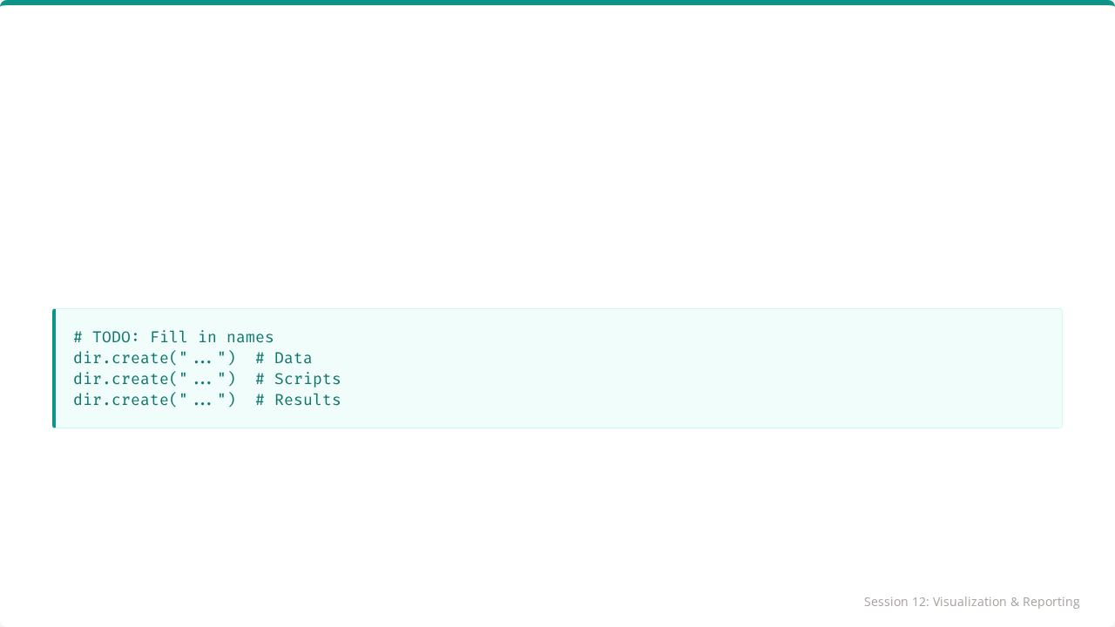
Step 1: Project Structure
Use dir.create() to make the folders.
Verify with list.dirs().

Slide 32
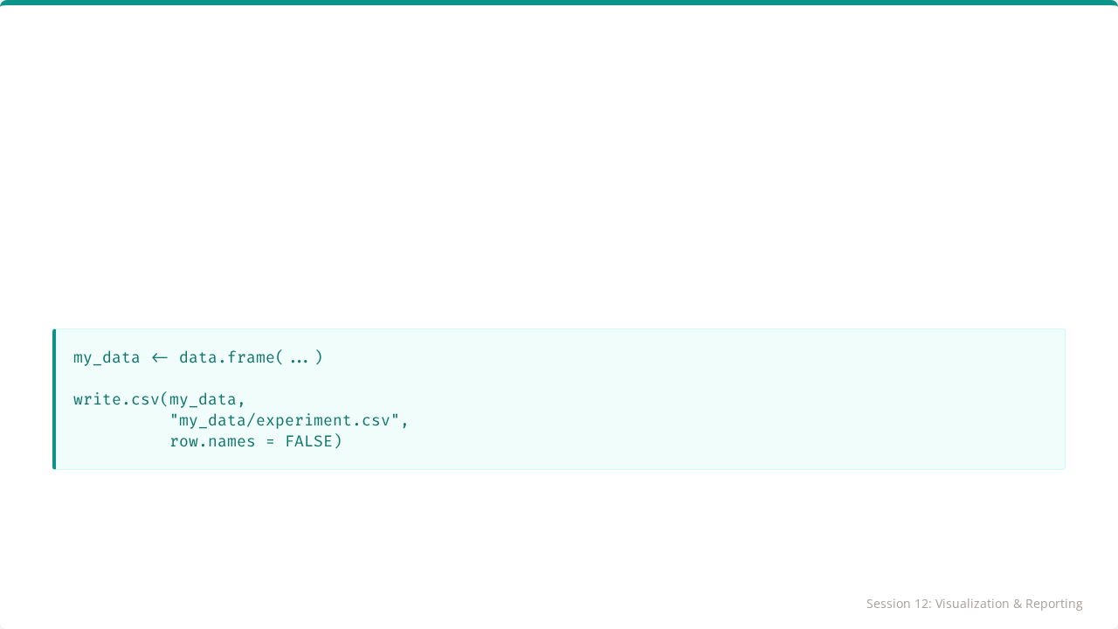
Step 2: Create Data
Create a simple CSV file in the data folder.

Slide 33
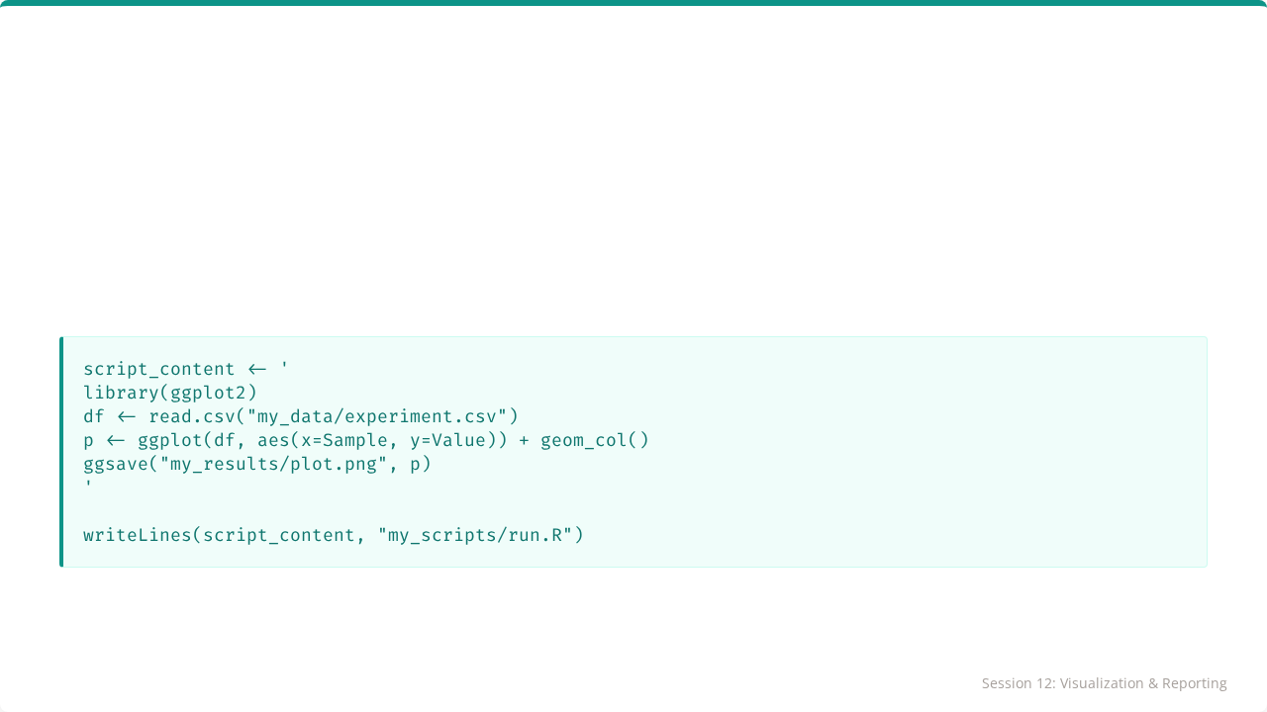
Step 3: Write Script
We will programmatically create a script file.

Slide 34
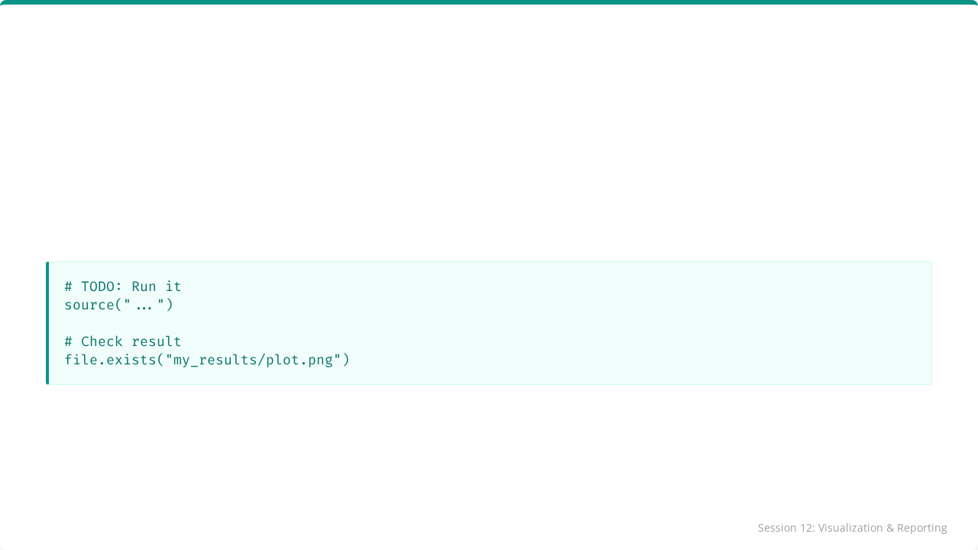
Step 4: Execute Pipeline
Run the script using source().
If true, you have successfully built an automated pipeline!

Slide 35

Session 12 Complete
Congratulations on completing the module!

